Slide 1
A PROJECT PLAN FOR LANDSCAPING THE BACK YARD
Student’s Name
Institutional Affiliations

Slide 2
Project Overview
The project involves the landscaping of a backyard.
The activities include leveling the ground, planting of flowers and trimming of hedges as well as planting grasses and creating drainage terraces
The project is estimated to cost $4000 and is expected to run for two weeks.
The project manager will be in charge of coordinating all the activities of the project.
The number of manual laborers involved will be 3.
The project outcome is the landscaping of the backyard to be handed over to the owner.
Notes:
This project will deal with the landscaping of the backyard. This involves the planting of flowers, trimming of hedges and trees and mowing of the lawn. This project is expected to take a maximum of two weeks in which all the activities will have been concluded. The budget estimate for the project is about $4000 and this will be allocated to the various activities that will be undertaken during the course of the project. In terms of management of the project, there will be a project manager that will be reporting to the director who is the owner of the backyard. The project manager will manage all the functions of the project and will be assisted by the supervisors. The project will require about 3 manual laborers that will be working on the backyard for the duration of the project. The necessary materials and resources that is required for the project will be outsourced and this will be delivered way before the project begins in order to avoid any disruption. The outcome that the project is intended to achieve is that of the backyard being landscaped and this is hoped to be achieved by the end of the project. The project will close in two weeks’ time and the deliverable handed over to the owner.

Slide 3
Project Mission Statement and Scope Statement
The mission: To provide a backyard landscape that is suitable for undertaking of outdoor activities and for maximum relaxation
Scope Statement: The project will mainly involve activities of landscaping the backyard to create a levelled ground and serene environment at the back yard.

Slide 4
Project Schedule And Control
The project is expected to take a maximum of two weeks for its completion.
The initial phase of the project will run for two days.
The owner is expected to be handed over the backyard at the end of the stipulated project period of two weeks.
The activities involved include the purchase and mobilization of the materials to the backyard and the planting of flowers and trimming of hedges.
The resource allocation of the project will be based on the budget figure of $4000.
The project manager will be responsible for the allocation of the resources needed for the project.
The monitoring and control of the project will be undertaken by the project manger and assisted by the supervisors.
The project manager will be present at the site in order to check and evaluate the progress of the project.
The project manager will formulate checks at specific intervals of the projects to ascertain if the project is running according to plan.
Assessment and evaluation will be done by the project manager in order to control the use of resources and funds
Notes:
The project schedule defines the program and time of activities to be undertaken in the project and the processes that are used in controlling and monitoring the project (Meredith, Mantel & Shafer, 2017).the project schedule is important as it ensures that the project follows a laid out guideline e which will lead to the project being completed within the stipulated time. This is an important part of the project plan as it enables one to save on time and costs. The landscaping of the backyard will last for two weeks and the various activities will be allocated specific times in order to know if the project is running on schedule. Resource allocation also involves the utilization of funds that are available for the project. Therefore, the allocation will be done based on the activities that have the highest priority up to the one with the lowest. This is in order to ensure that the most required activity is carried out first which will go a long way in ensuring that the success of the project is achieved. The landscaping of the backyard involves various activities such as creating the zones for activities and putting up of various plants that beautify the backyard .This involves careful consideration and thus the schedule for this is important in ensuring that they undertaken within the required time and that it is done in an efficient way. The controlling and monitoring process is also essential for the success of the project. (Meredith, et al., 2017). . The monitoring process will also involve the analyzing of the costs used as the project goes on in order to ascertain if the project is still running as per the required budget. This is an important part as it will enable any necessary changes to be made early enough in the project and this will prevent the project from failing due to lack of funds.

Slide 5
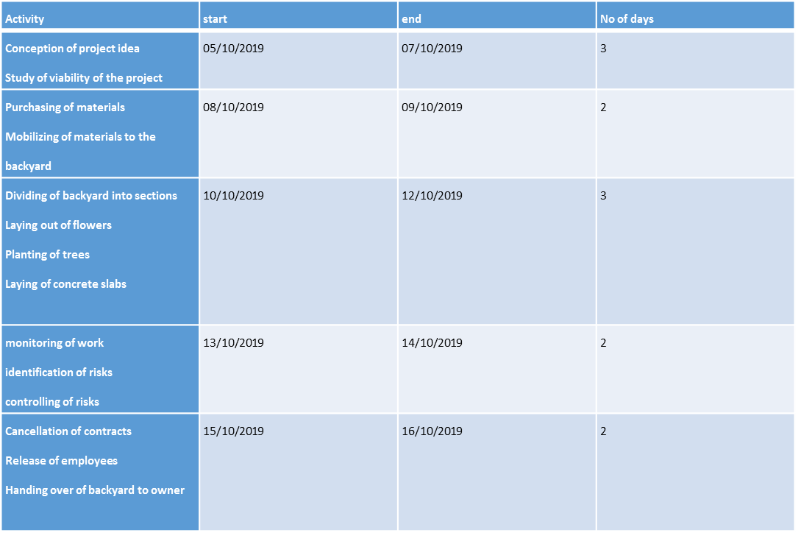
Project Schedule and Control

Slide 6
Project Management Structure And Budget
The project management structure ensures coordination and implementation of the project activities.
The director is the overall head of the project and is also the owner of the backyard.
The project manager controls all the activities of the project and reports to the director.
The project manager is in charge of supervisors or leaders who include the construction, safety and design leaders.
The staffs or the manual laborers are at the bottom of the structure and carry out the work on the ground. They report to the supervisors.
The budget is structured based on the importance of the activities to be carried out.
Director
Project manager
Construction leader
Design leader
Safety leader
Staff
Staff
Staff
Notes:
The project management structure is a structure that facilitates the smooth undertaking of the activities that are involved in the project (Newton, 2016). This is an important aspect of the project as it ensures that there are minimum disruption of the project and also eliminates any form of conflicts that might be there in regards to the activities that have been allocated to various individuals.
The management structure is designed in a way that will have the owner of the backyard as the director. The project manager will come in after the director and will be reporting directly to the director. The work of the project manager will be to ensure that the project runs according to plan up to its completion. The design leader, construction leader and safety leader will all be under the project manager and will ensure that all the activities that they are in charge of are carried out efficiently. These leaders will then be in charge of the staffs who will be undertaking the various activities.

Slide 7
Work Breakdown Structure
Work breakdown involves the breakdown of activities into smaller components.
The landscaping of the backyard follows a work break down structure that details the responsibilities and days taken to carry out the work.
The coming up with the project falls under the responsibility of the director and will take a day.
The project manager will undertake the fiscal study and mobilization of resources and this will be done for a period of three days.
The allocation of resources and monitoring of the project will be handled by the team leaders with the overall assistance of the project manager. This will take a further two days for it to be done.
The assessment of risk will take 2 days and will be the duty of the project manager who will be obligated to inform the director.
The staff or the manual laborers will undertake the work on the ground to its completion and this will require 2days.
The project manager will then compile and hand over a report of the project and the project itself to the director within 2 days.
Notes:
A work breakdown structure is a breakdown of the activities that are involved in the project into smaller components that eases the understanding of the work needed. (Meredith, et al., 2017). ). It is an important part of the project as it outlines the deliverables that are required of the project and organizes them into manageable sections. This ensures that there is proper management of the work and that the various individuals tasked with various responsibilities are able to account for their work.

Slide 8
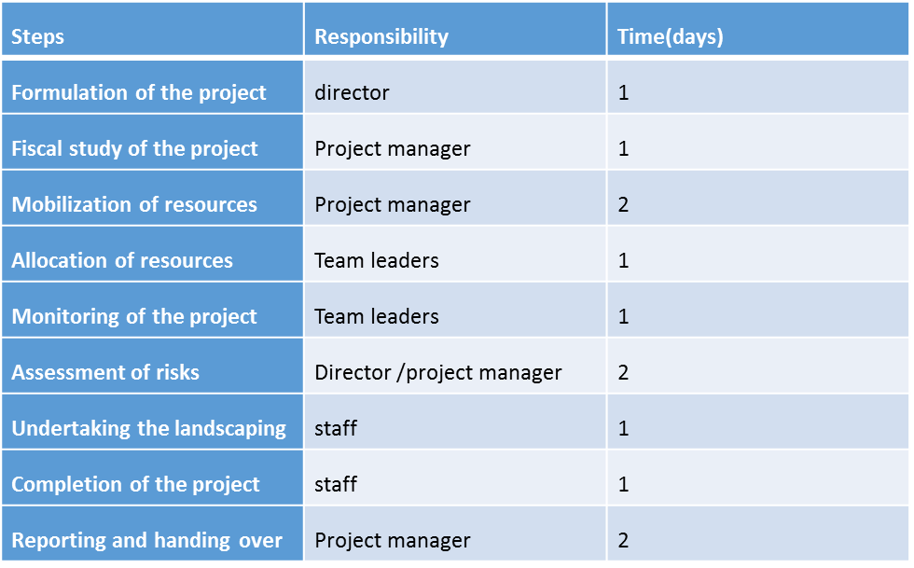
Work Breakdown Structure Table

Slide 9
Risk Management Process
Risk management is the process of identifying and managing potential risks.
The risks that face the landscaping of the backyard include low budget, staff opting to quit work and late delivery of resources among others.
The budget estimated may be lower thus posing a risk of the landscaping not being completed.
The budget for this project will be scrutinized from time to time to ensure that the funds are adequate and thus prevent delays.
One or all of the staffs may leave work and this will create a risk of the project falling behind the schedule of two weeks.
The project manger will ensure that the staffs are well paid and in time to avoid the prospects of them joining other projects.
The backyard landscaping face a risk of the suppliers not delivering the material in good time which will cause the project to stall.
The acquisition of materials will be done ahead of the start of the project to ensure that they are readily available at the time of use. This will minimize disruptions and delay of the project.
Injuries are bound to occur to people and therefore, a full equipped first aid kit will be required.
Notes:
Risk management process is therefore the process of identifying and managing the potential risk that may be there in a project in order to minimize the negative effects that they may have on the project (Cleden, 2017). This will ensure that the risk are identified at an early stage and that adequate measures are taken in order to deal with the problem. The risk management process requires the involvement of all the stakeholders of the project in order to deal with the risk effectively. The project plan for the backyard landscaping will also involve a risk management process. This will be in the form of identifying the potential challenges that the project will face such as natural disasters, under budgets, inadequate employees and project delays. This are some of the risks that may contribute to the landscaping project not to run smoothly and thus appropriate measures need to be formulated in order to counter them.
The project may also be faced with the risk of resources in terms of the acquisition and delivery (Cleden, 2017). This may be occasioned by the lack of adequate funds or the delay in the delivery of the same by the suppliers. This will result in the backyard landscape to delay and thus the intended activities will to be able to kick off. It is therefore important to ensure that this is managed in a proper way. This will involve engaging the suppliers of the resource such as planting materials, slabs, and timber way before the start of the project in order to ensure that the resources are available at the time that they will be required. This will give time to the suppliers to plan themselves accordingly and thus avail the resources in a good time.
The stipulated budget for the landscaping of the backyard may have been underestimated and this is something that may lead to the delay or the closure of the project. Therefore, the budgets will be properly scrutinized in order to ensure that the funds allocated to various activities are adequate and therefore minimize the disruptions that any arise once the project has kicked off. This is essential as it will ensure that the project runs smoothly form the start to the end.
The employees in the project are very crucial in determining the timely completion of the project and thus it is important that there welfare is looked into. The project plan will therefore involve catering for the interest of the employee in terms of their salaries and work overload in order to prevent them from quitting and going to other projects. This will be important as it will ensure that the project is running smoothly and that there are no delays that may be occasioned by some of the employee leaving their work. This will in the long run ensure that the project is completed according to the stipulated timeline.

Slide 10
Project Communication
It involves the passing of information between the project members.
Communication in the landscaping project will involve the owner of the project and the team members.
The communication will be done from top to bottom and from bottom to top.
The owner will inform the project manager of the requirements of the backyard landscape project and this will be passed to the other team members.
The staff working in the backyard will communicate the challenges they face to the supervisors and project manager in order for appropriate action to be taken.
However, the communication will be more informal with the owner of the project sharing and receiving ideas from other project team members.
Notes:
Project communication is essential in ensuring that the objectives of the project are passed onto the relevant stakeholder and that they are met in a timely manner (Lock, 2017). The success of the project will depend on how communication has been passed effectively to all the team members and how the same has been implemented. This minimizes the risks that may be there as the team members will all be aware of what they are required to do.
This is essential in the project of landscaping of the backyard as it will ensure that the employees are able to understand the requirements of the project and thus deliver the work in accordance with the laid down requirements. This will involve informing the project manager of how the landscape needs to be designed in order to provide a cool and conducive environment. The project manager will then instruct the various leaders on this requirements who will in turn inform their staffs of the need to stick and deliver the required plan. The information will have been communicated and this will ensure that the project is delivered according to the required plan. Communication will also ensure that the challenges that may face the landscaping project will be communicated to the project manager in an efficient way and this will result in action being taken in a timely manner. This will reduce the effects of the challenges on the projects and thus the project will still be on course.

Slide 11
Project Closure
This is the last phase of a project.
The project manager will release the staffs who have been working on the backyard together with the supervisors.
The contracts that will have been signed for the undertaking of the landscaping of the backyard will be cancelled during this period.
Any equipment that will have been hired for the purpose of undertaking the landscaping project will be returned.
The project members will clear the site of any unnecessary objects.
The project manager will hand over the backyard to the owner.
Notes:
Project closure is the last phase of the project and involves the handing over of the deliverables to the owner of the project (Meredith, et al., 2017). This is done after the completion of the project in which there is passage of the documentations to the stakeholders, cancellation of supplier contracts, releasing of staff and equipment’s and informing of the stakeholders of the closure of the project.
The project plan will detail the relevant activities that will be done during the closure of the project. This will include releasing the employees who have been working in the backyard for the last few days and the return of any equipment that may have been hired for the purpose of conducting the project. The project manager of this backyard landscaping will then hand over all the necessary documentations that are of importance to the owner of the backyard. This will assist him in going through the dynamics of the project will be useful for future cases. The project manager will then proceed to cancel all the supplier contracts that may have been there as there would be no need for any resources to be delivered since the project is complete. The last activity of the closure of this project will be to inform the owner of the closure of the project and hand over the deliverable which is the landscaping of the backyard to him.

Slide 12
References
Cleden, D. (2017). Managing project uncertainty. Routledge.
Lock, D. (2017). The essentials of project management. Routledge.
Meredith, J. R., Mantel Jr, S. J., & Shafer, S. M. (2017). Project management: a managerial approach. John Wiley & Sons.
Newton, R. (2016). Project management step by step: how to plan and manage a highly successful project. Pearson UK.

